Slide 1
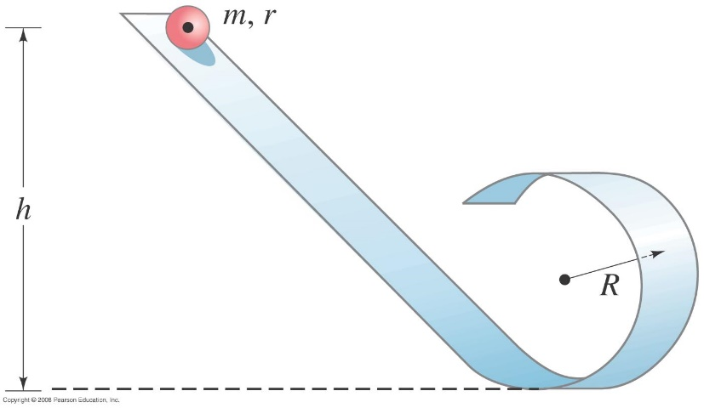
Homework 8 (Chap 10)
1. Gioncoli Textbook, problem 86. page 281
z
2. As shown in Fig. 1, three thin rods, a, b, and c are joined together such that rod a is parallel to the x-axis, rod b lies on y-axis with z-axis passing its mid-point, and rod c is parallel to the z-axis. Each rod has the same mass M and length L, what would be the moment of inertia if the joined rod structure rotates around the z-axis? (Assume the radius of the rod is nearly zero)
c
b
a
y
x
Fig 1
3. A marble of mass m and radius r rolls along the looped rough track of Fig. 2 below. What is the minimum value of the vertical height h that the marble must drop if it is to reach the highest point of the loop without leaving the track?
(a) Assume
(b) do not make this assumption. Ignore frictional losses.
Fig. 2

Slide 2
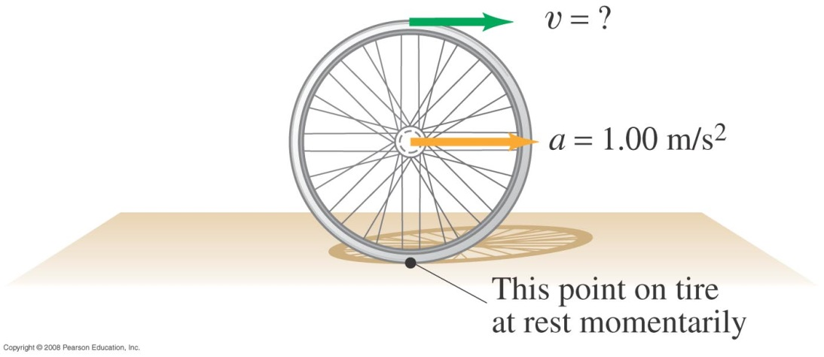
86. A cyclist accelerates from rest at a rate of 1m/sec² How fast will a point at the top of the rim of the tire (diameter = 68cm) be moving after 2.5 s? [Hint: At any moment, the lowest point on the tire is in contact with the ground and is at rest — see Fig. 10–63.]
Assume that the velocity of the bike is v_{b}, and the velocity at the top of the rim of the tire is v, since the wheel execute pure rotation, therefore
,where ω is the angular speed of the wheel rotation, and R=0.68 m the radius of the wheel.
Since the acceleration a of the bike is 1m/sec², we have

Slide 3
2. As shown in Fig. 1, three thin rods, a, b, and c are joined together such that rod a is parallel to the x-axis, rod b lies on y-axis with z-axis passing its mid-point, and rod c is parallel to the z-axis. Each rod has the same mass M and length L, what would be the moment of inertia if the joined rod structure rotates around the z-axis? (Assume the radius of the rod is nearly zero)
z
c
b
a
y
x
Fig 1

Slide 4

HW8-3 :
A marble of mass m and radius r rolls along the looped rough track of Fig.
What is the minimum value of the vertical height h that the marble must drop if it is to
reach the highest point of the loop without leaving the track?
(a) Assume
(b) do not make this assumption. Ignore frictional losses.

Slide 5
For pure roll on flat surface (R>>r),
For the ball to pass the top, the gravitational force only should provide the acceleration for the boll, i.e.

Slide 6


Now for pure roll on a circle:
Path of the center
The arc length the ball rolled over.

Slide 7
For pure roll on a circle,

